Slide 1
Deep Multi-patch Attention Network for Single Image Deblurring
學生: 許家誠
指導教授: 張隆紋

Slide 2
outline
Motivation
Introduction
Related work
Proposed method
Experiment
Result

Slide 3
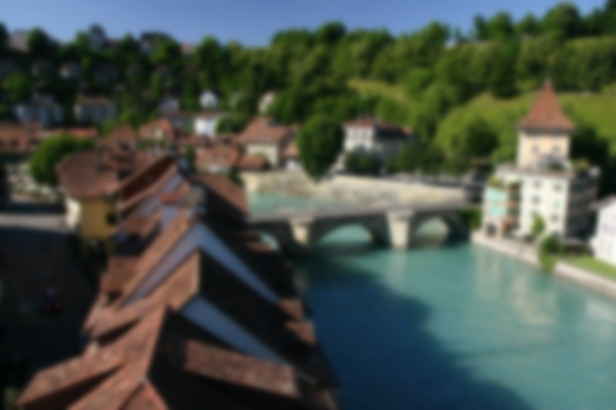
Motivation
When taking pictures, often occur handshake and other situations that make the image blurry
Image deblurring has been an important issue in computer vision problem

Slide 4
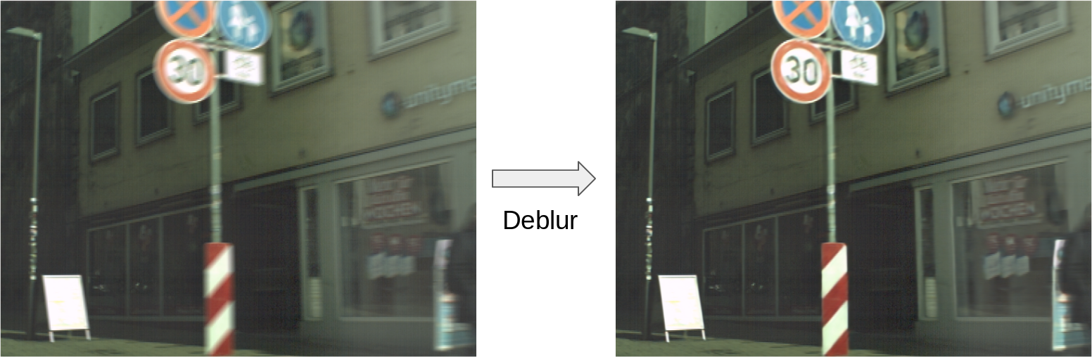
Introduction
Related work
Proposed method
Experiment
Conclusion

Slide 5

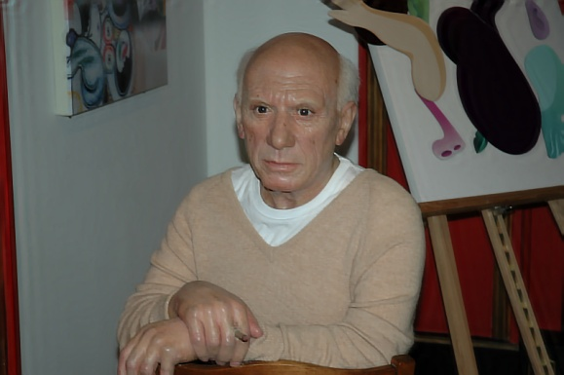


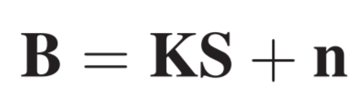
Introduction
Related work
⊗
Proposed method
Experiment
Blurred image I
Sharp image L
Blur kernel f
Conclusion
Camera Noise n

Slide 6
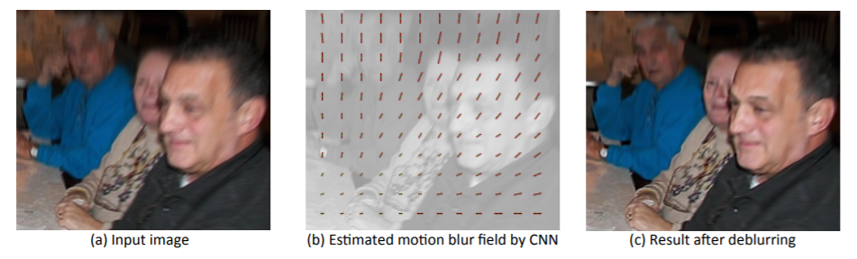
Introduction
Related work
Proposed method
Experiment
Conclusion
-- [1] J. Sun et al. Learning a Convolutional Neural Network for Non-uniform Motion Blur Removal CVPR 2015

Slide 7
Related Works
Introduction
1. Skip connection
ResNet [2]
DenseNet [3]
2. Attention mechanism
Channel Attention [7]
Spatial Attention
CBAM [8]
3. Deblurring works
Deep multi-scale convolutional network [4]
Scale-recurrent Network [5]
Deep Stacked Hierarchical Multi-patch Network for Image Deblurring [6]
Related work
Proposed method
Experiment
Conclusion

Slide 8
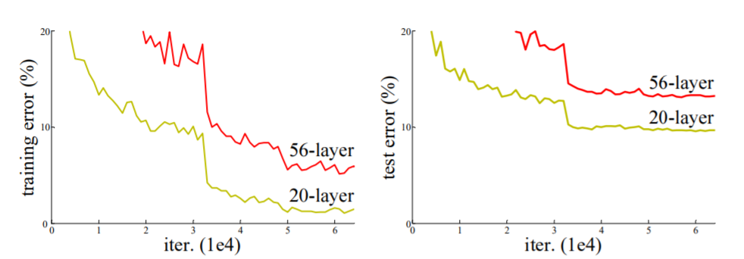
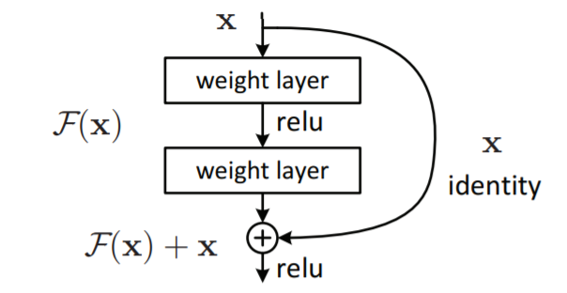
ResNet
Introduction
Related work
Skip connections
Deblurring works
Attention mechanism
Proposed method
Experiment
Conclusion
--[2] K. He Deep Residual Learning for Image Recognition CVPR 2015

Slide 9
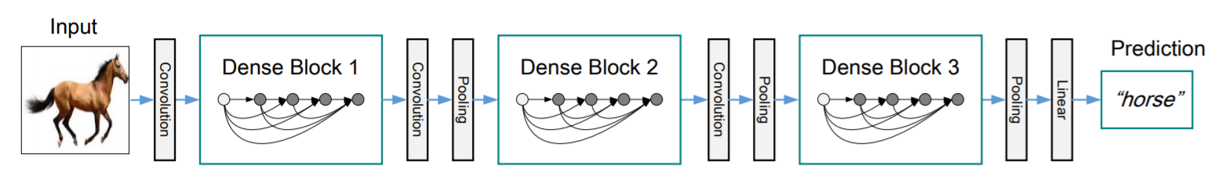
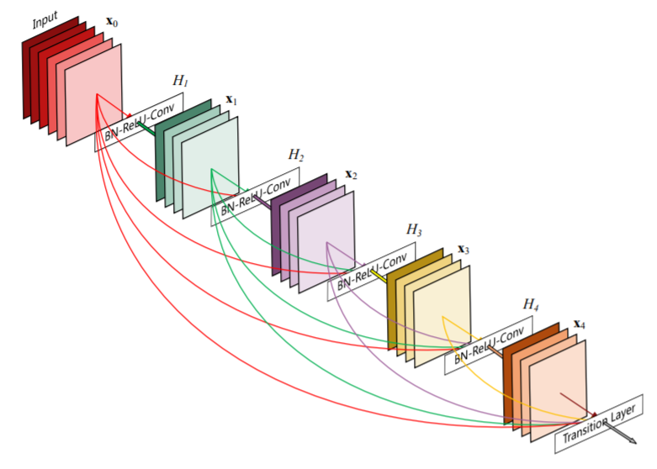
DenseNet
Introduction
Related work
Skip connections
Deblurring works
Attention mechanism
Proposed method
Experiment
Conclusion
-- [3] G. Huang, Z. Liu, K. Q. Weinberger, and L. Maaten. Densely connected convolutional networks. In CVPR, 2017

Slide 10
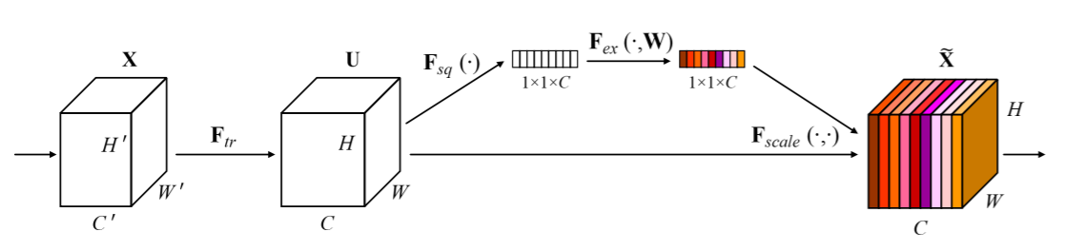
Squeeze-and-Excitation Networks
Introduction
Related work
Skip connections
Deblurring works
Attention mechanism
Proposed method
Experiment
Conclusion
-- [7] J. Hu, L. Shen, and G. Sun. Squeeze-and-excitation networks. arXiv preprint arXiv:1709.01507, 2017

Slide 11
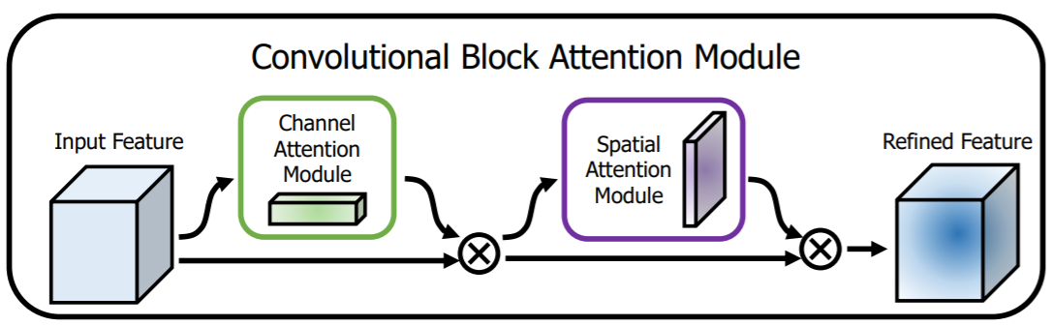
Convolutional Block Attention Module
Introduction
Related work
Skip connections
Deblurring works
Attention mechanism
Proposed method
Experiment
Conclusion
-- [8] Woo, S., Park, J., Lee, J. Y., & So Kweon, I. (2018). Cbam: Convolutional block attention module.
In Proceedings of the European Conference on Computer Vision (ECCV) (pp. 3-19).

Slide 12
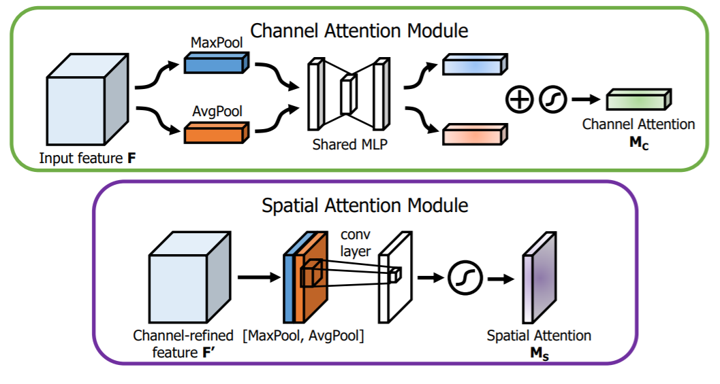
Convolutional Block Attention Module
Introduction
Related work
Skip connections
Deblurring works
Attention mechanism
Proposed method
Experiment
Conclusion
-- [8] Woo, S., Park, J., Lee, J. Y., & So Kweon, I. (2018). Cbam: Convolutional block attention module.
In Proceedings of the European Conference on Computer Vision (ECCV) (pp. 3-19).

Slide 13
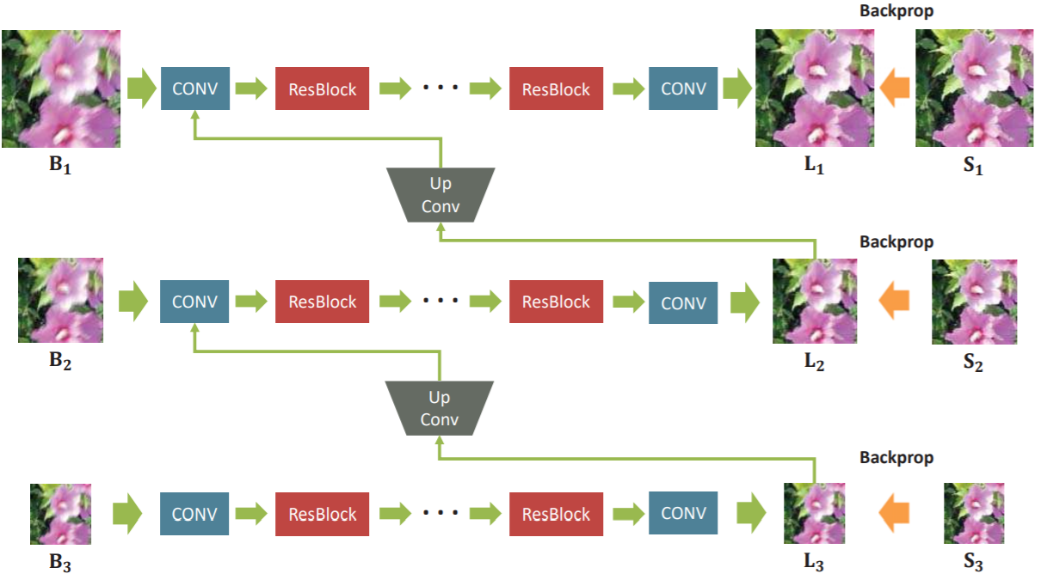
Deep multi-scale convolutional network
Introduction
Related work
Skip connections
Deblurring works
Attention mechanism
Proposed method
Experiment
Conclusion
-- [4] S. Nah Deep Multi-scale Convolutional Neural Network for Dynamic Scene Deblurring In CVPR 2017

Slide 14
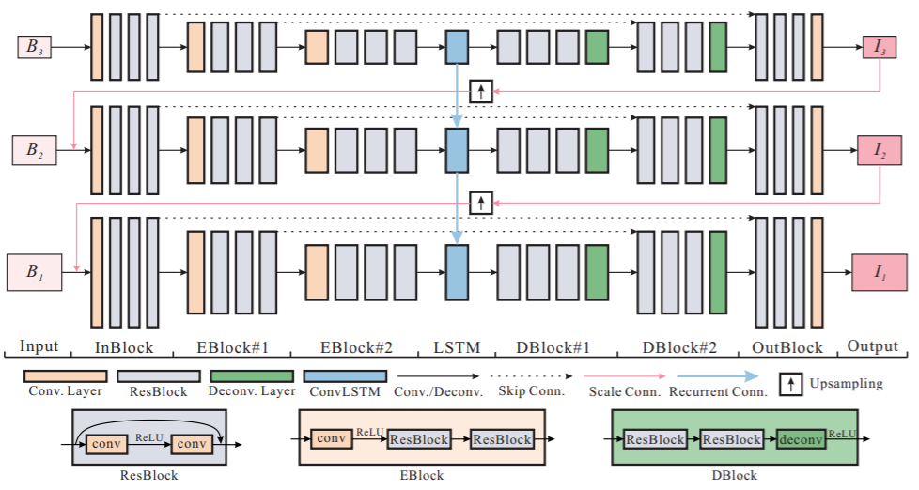
Scale-recurrent Network
Introduction
Related work
Skip connections
Deblurring works
Attention mechanism
Proposed method
Experiment
Conclusion
-- [5] X. Tao Scale-recurrent Network for Deep Image Deblurring. In CVPR 2018

Slide 15
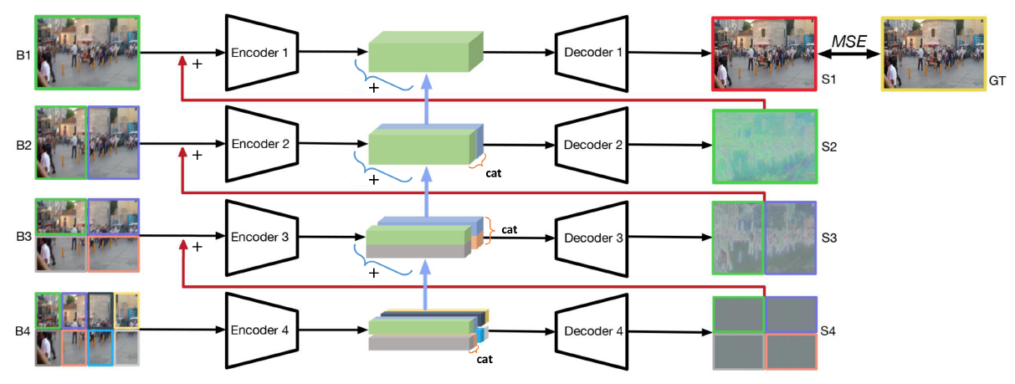
Deep Stacked Hierarchical Multi-patch Network for Image Deblurring
Introduction
Related work
Skip connections
Deblurring works
Attention mechanism
Proposed method
Experiment
Conclusion
-- [6] H. Zhang et.al. Deep Stacked Hierarchical Multi-patch Network for Image Deblurring. In CVPR 2019

Slide 16
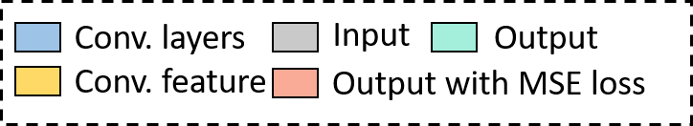
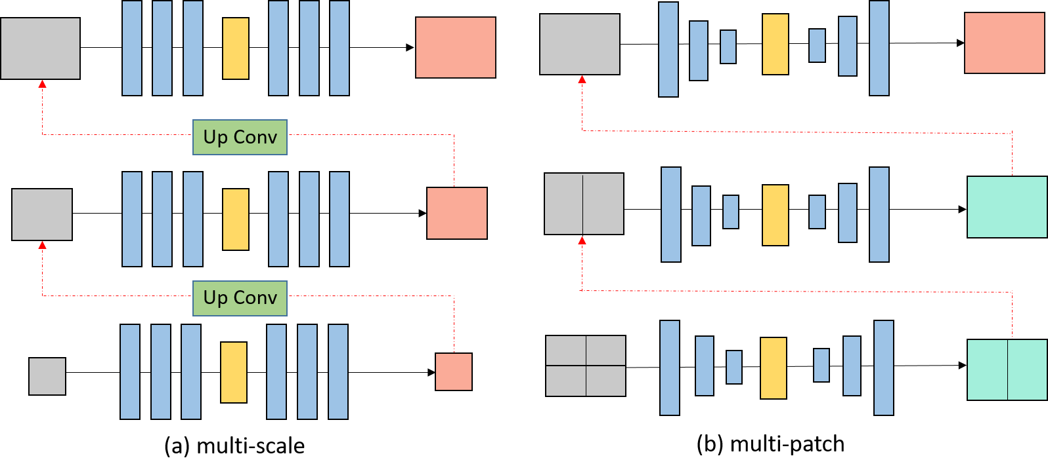
Different architecture
Introduction
Related work
Skip connections
Deblurring works
Attention mechanism
Proposed method
Experiment
Conclusion
Overall CNN-based deblurring method

Slide 17
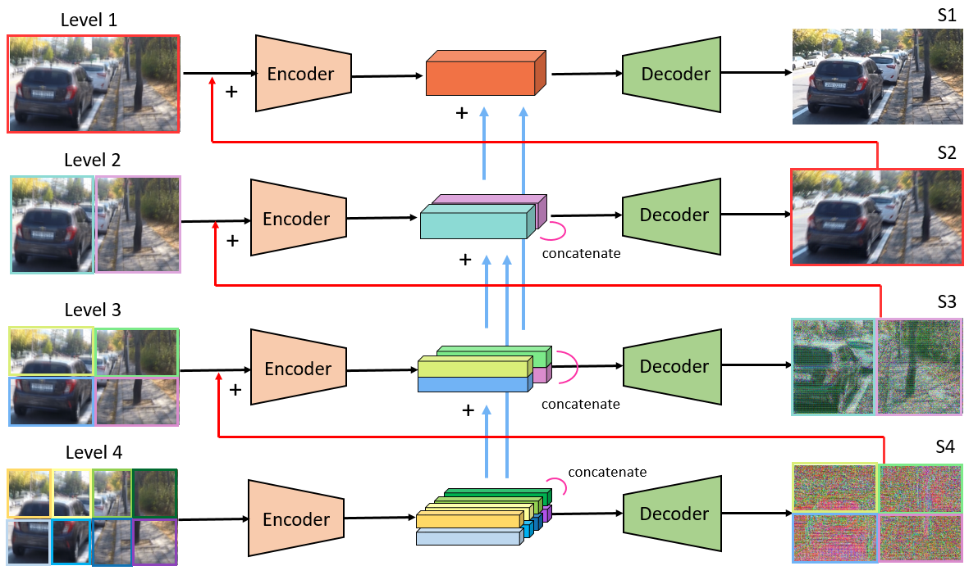
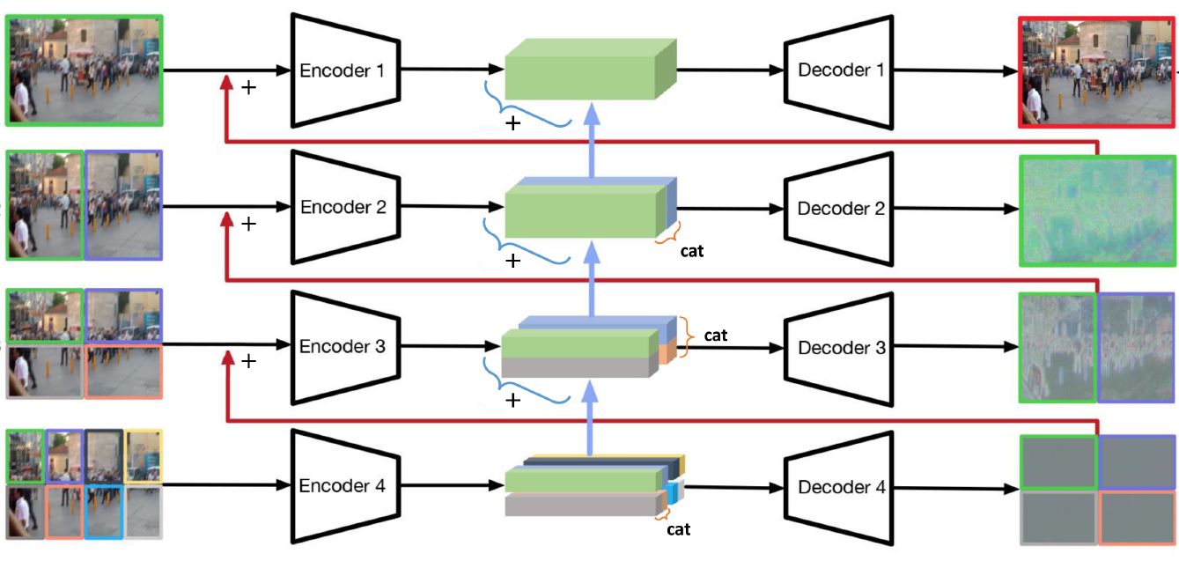
Proposed method
Introduction
Related work
Ours DMPAN
DMPHN
Proposed method
Overview
Encoder-decoder
Skip connection
Experiment
Conclusion
Based on . Deep Stacked Hierarchical Multi-patch Network for Image Deblurring (DMPHN)
Use multi-patch architecture
Improve network flow and encoder-decoder structure

Slide 18
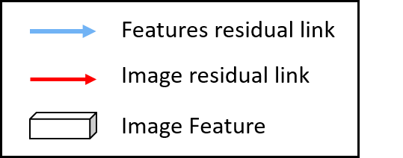
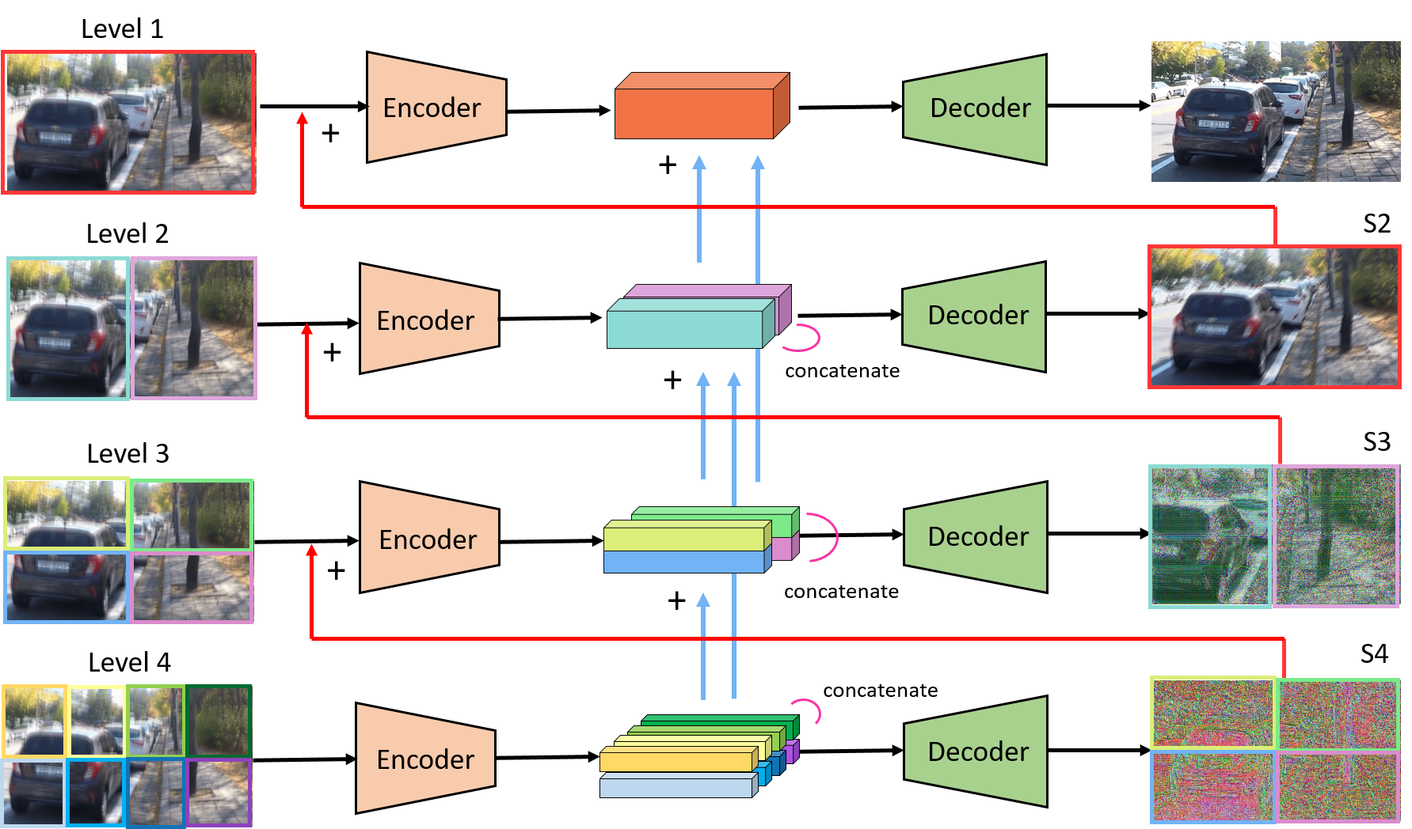
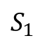
Deep Multi-patch Attention Network
Introduction
$$S_{1}$$
Related work
Proposed method
Overview
Encoder-decoder
Skip connection
Experiment
Conclusion

Slide 19
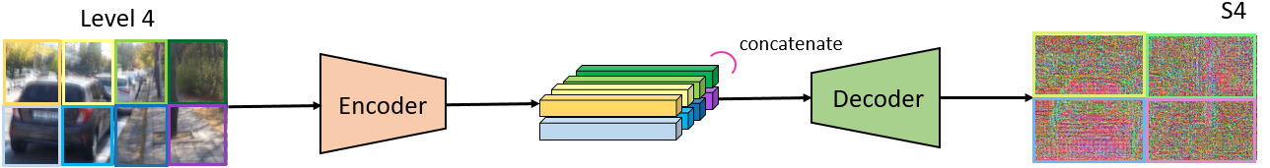
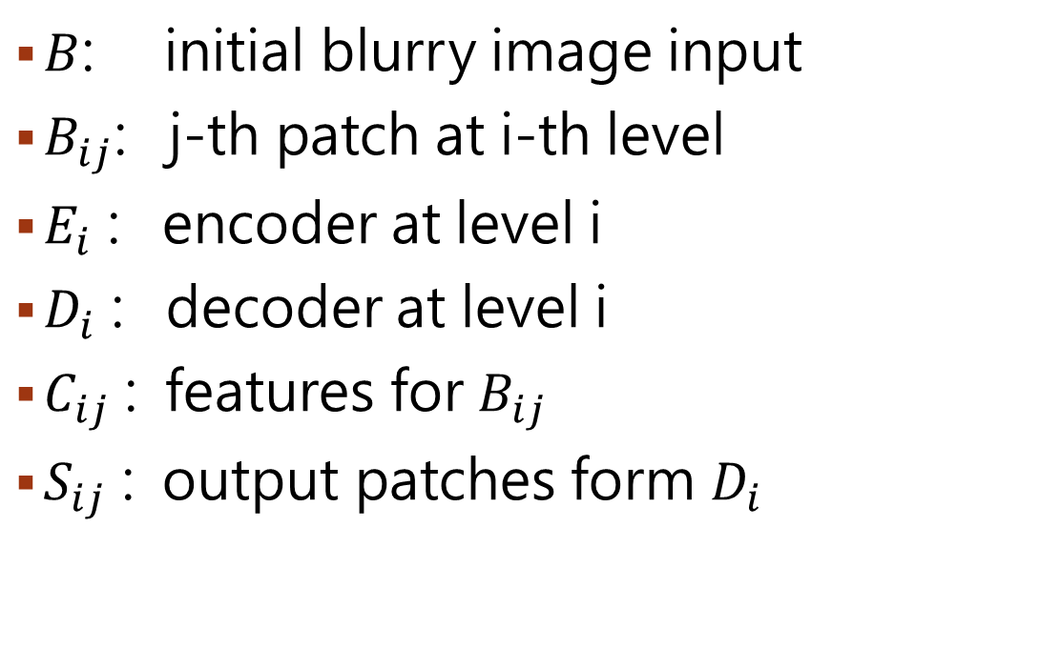
Network flow representation
Introduction
Related work
Proposed method
Overview
Encoder-decoder
Skip connection
$B$: initial blurry image input
$B_{ij}$: j-th patch at i-th level
$E_{i}$ : encoder at level i
$D_{i}$ : decoder at level i
$C_{ij}$ : features for $B_{ij}$
$S_{ij}$ : output patches form $D_{i}$
Experiment
Conclusion

Slide 20
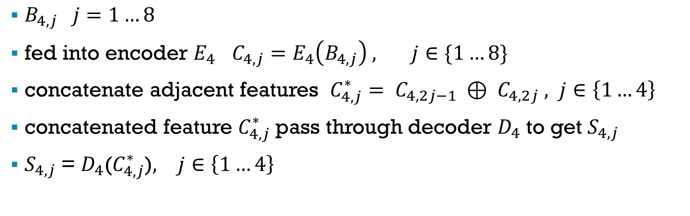
Level 4
Introduction
Related work
Proposed method
Overview
Encoder-decoder
Skip connection
$B_{4,j} j=1…8$
fed into encoder $E_{4}$ $C_{4,j}=E_{4}\left(B_{4,j}\right) , j∈\{1…8\}$
concatenate adjacent features $C_{4,j}^{∗}= C_{4,2j−1} ⊕ C_{4,2j} , j∈\left\{1…4\right\}$
concatenated feature $C_{4,j}^{∗}$ pass through decoder $D_{4}$ to get $S_{4,j}$
$S_{4,j}$ = $D_{4}$($C_{4,j}^{∗}$)$, j∈\left\{1…4\right\}$
Experiment
Conclusion

Slide 21
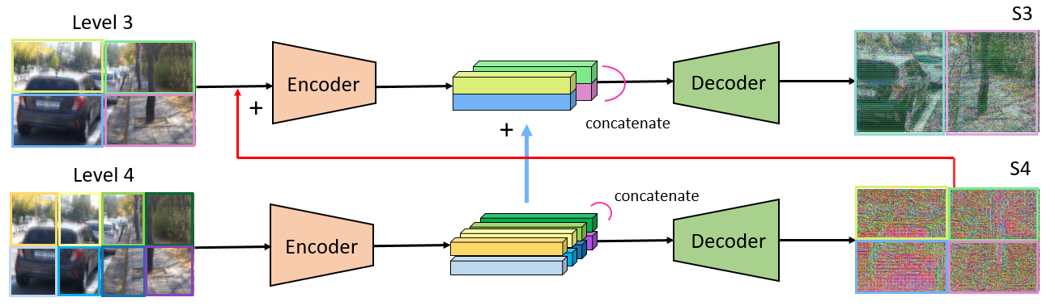
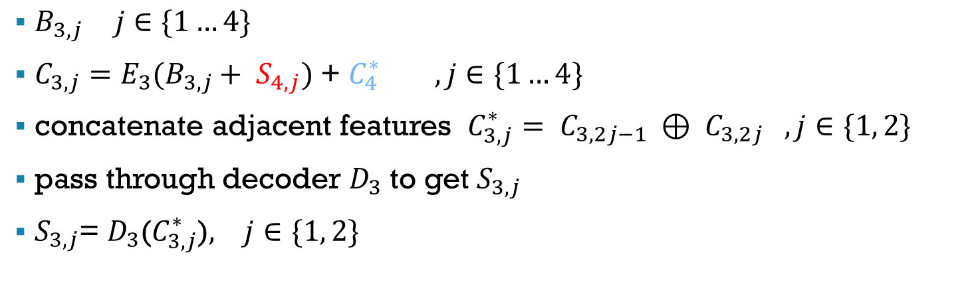
Level 3
Introduction
Related work
Proposed method
Overview
Encoder-decoder
Skip connection
$B_{3,j} j∈\{1…4\}$
$C_{3,j}=E_{3}(B_{3,j}+ S_{4,j})$ + $C_{4}^{∗} , j∈\{1…4\}$
concatenate adjacent features $C_{3,j}^{∗}= C_{3,2j−1} ⊕ C_{3,2j} ,j∈\{1, 2\}$
pass through decoder $D_{3}$ to get $S_{3,j}$
$S_{3,j}$= $D_{3}$($C_{3,j}^{∗}$)$, j∈\{1, 2\}$
Experiment
Conclusion

Slide 22
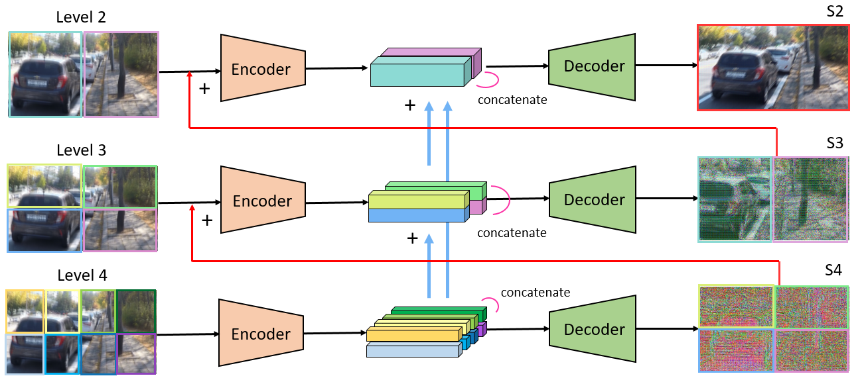
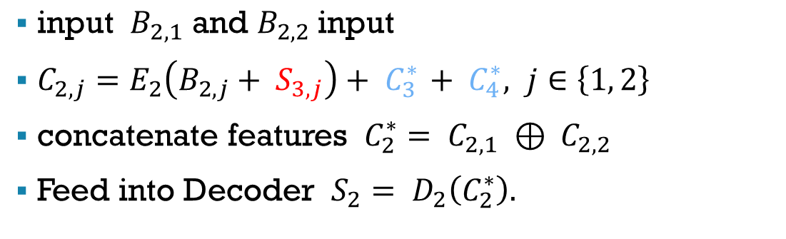
Level 2
Introduction
Related work
Proposed method
Overview
Encoder-decoder
Skip connection
Experiment
${\text{input} B}_{2,1} \text{and} B_{2,2} \text{input}$
$C_{2,j}=E_{2}\left(B_{2,j}+ S_{3,j}\right)+ C_{3 }^{∗}+ C_{4}^{∗}, j∈\left\{1, 2\right\}$
concatenate features $C_{2}^{∗}= C_{2,1} ⊕ C_{2,2}$
Feed into Decoder $S_{2}= D_{2}\left(C_{2}^{∗}\right).$
Conclusion

Slide 23
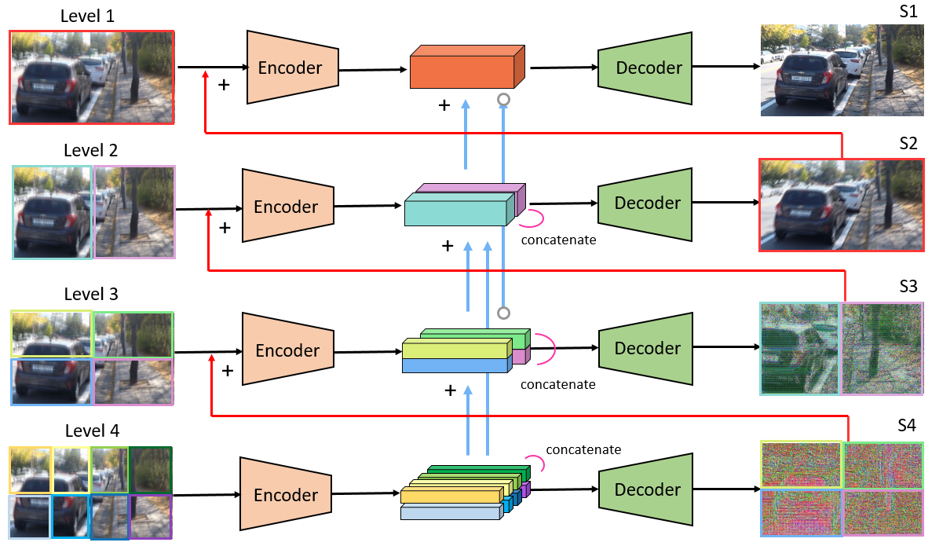
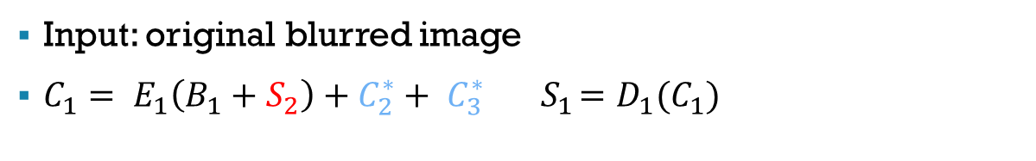
Level 1
Introduction
Related work
Proposed method
Overview
Encoder-decoder
Skip connection
Experiment
Conclusion
Input: original blurred image
$C_{1}= E_{1}\left(B_{1}+S_{2}\right)+C_{2}^{∗}+ C_{3 }^{∗}{ S}_{1}=D_{1}(C_{1})$

Slide 24
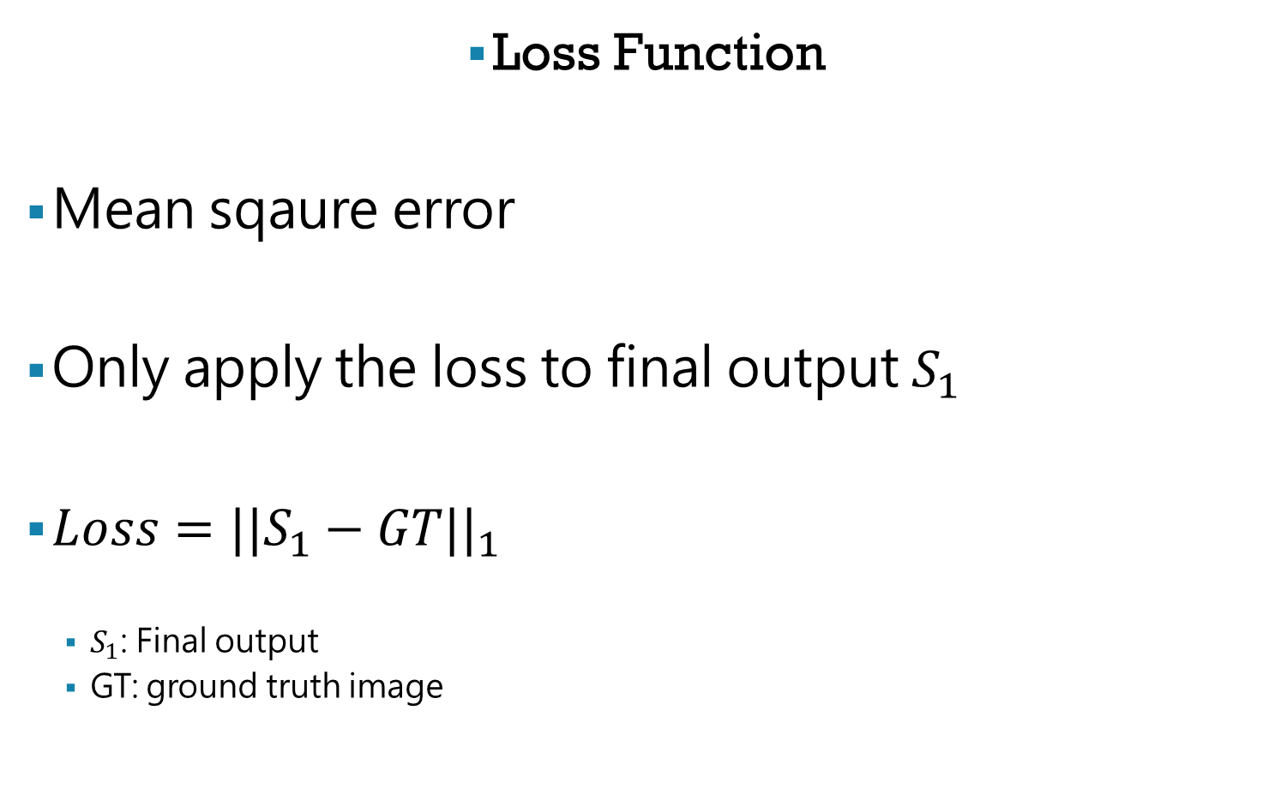
Introduction
Loss Function
Mean sqaure error
Only apply the loss to final output $S_{1}$
$Loss={||S_{1}−GT||}_{1}$
$S_{1}$: Final output
GT: ground truth image
Related work
Proposed method
Overview
Encoder-decoder
Skip connection
Experiment
Conclusion

Slide 25
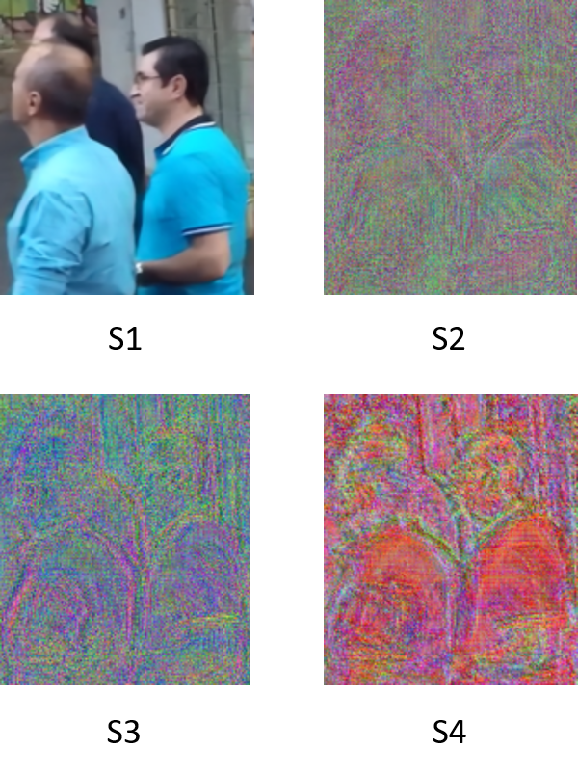
Network visualization
Introduction
Related work
Proposed method
Overview
Encoder-decoder
Skip connection
Experiment
Conclusion
Outputs $S_{i}$ for different levels of DMPAN(1-2-4-8)

Slide 26
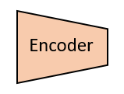
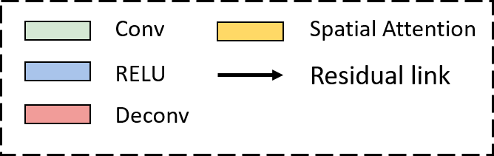
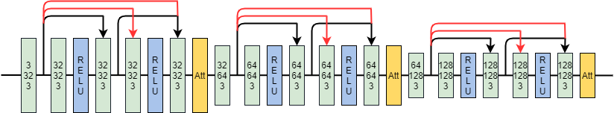
Encoder
Introduction
Related work
Proposed method
Overview
Encoder-decoder
Skip connection
Experiment
Conclusion
15 convolution layers
Attention module

Slide 27
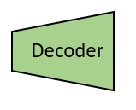
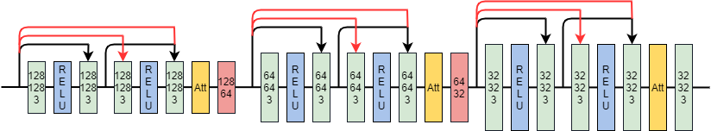
Decoder
Introduction
Related work
Proposed method
Overview
Encoder-decoder
Skip connection
Experiment
The architecture of decoder are identical to encoder
Two deconvolution for up sampling image
Conclusion

Slide 28
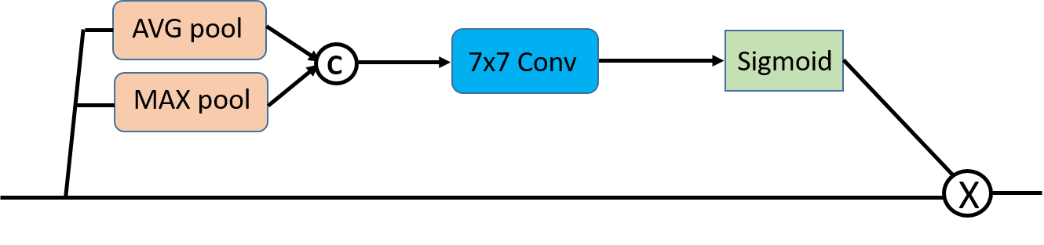
Attention module
Introduction
Related work
Proposed method
Overview
Encoder-decoder
Skip connection
Input feature size: W x H x C
Average pooling and max pooling operations along channel axis
W x H x 2
Get a W x H x 1 feature map
Experiment
Conclusion

Slide 29
Local skip connection
Introduction
Related work
Proposed method
Overview
Encoder-decoder
Skip connection
Experiment
Conclusion
Black links: same as the configuration of DMPHN encoder-decoder
Red local connections: enhance the feature propagation

Slide 30
Training details
Introduction
Subjects | Details
Input image size | 720x1280
Dataset | GoPro Dataset
# Training images | 2103
Batch size | 6
Optimizer | ADAM
Learning rate | Initialize to 0.0001, decade half every 1000 epochs
Loss function | Mean square Error
Machine | GTX 1080
Implementation | Pytorch
Training time | ∼10 days
Related work
Proposed method
Experiment
Training
comparison
Conclusion

Slide 31
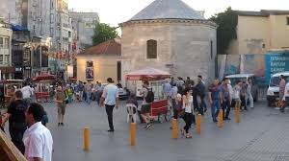
Training details
Introduction
Related work
GoPro Dataset:
Training set: 2103, Test set: 1111
Image size: 720 x 1280
Use GOPRO4 Hero Black camera to generate dataset.
Took 240 fps then averaged varying number (7 - 13) of successive latent frames to produce blurs of different strengths
Proposed method
Experiment
Training
comparison
Conclusion
-- [4] S. Nah Deep Multi-scale Convolutional Neural Network for Dynamic Scene Deblurring In CVPR 2017

Slide 32
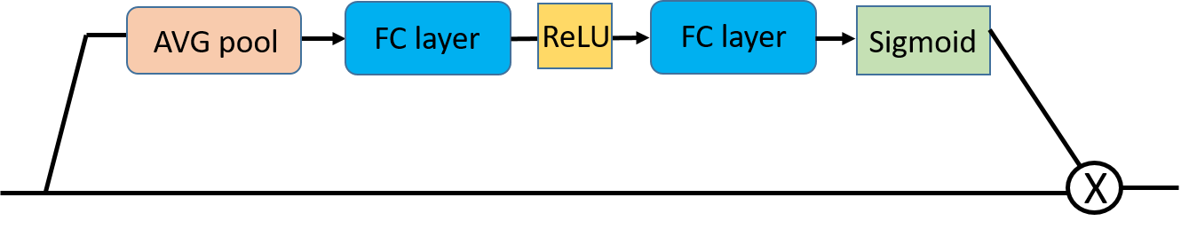
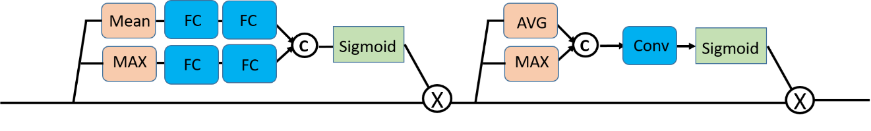
Comparison of different attention module
Introduction
Related work
Proposed method
(a) SE channel attention
Experiment
Training
comparison
(b) spatial attention
Conclusion
(c) CBAM block

Slide 33
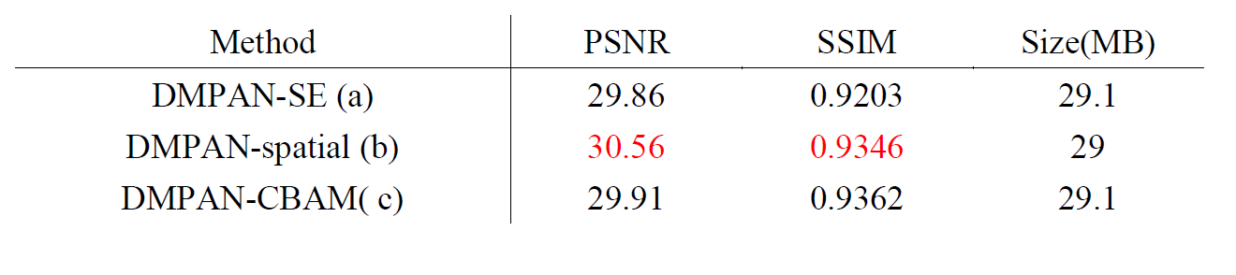
Comparison of different attention module
Introduction
Related work
Proposed method
Experiment
Training
comparison
Conclusion
Both (a) and (c) use channel attention, the experiment results show that spatial attention can improve performance

Slide 34
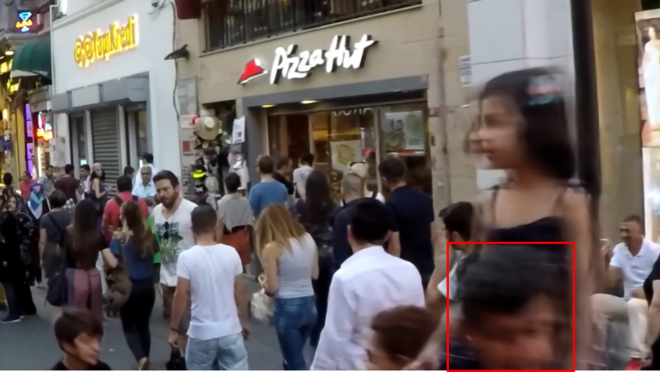



Comparison of different attention module
Introduction
Related work
Proposed method
Experiment
Channel attention (28.15/ 0.8765)
Spatial attention (30.40 / 0.9533)
Training
comparison
Conclusion
CBAM (28.43 / 0.9402)
Ground Truth

Slide 35




Comparison of different attention module
Introduction
Related work
Proposed method
Experiment
Training
comparison
Channel attention (28.15/ 0.8765)
Spatial attention (30.40 / 0.9533)
Conclusion
CBAM (28.43 / 0.9402)
Ground Truth

Slide 36
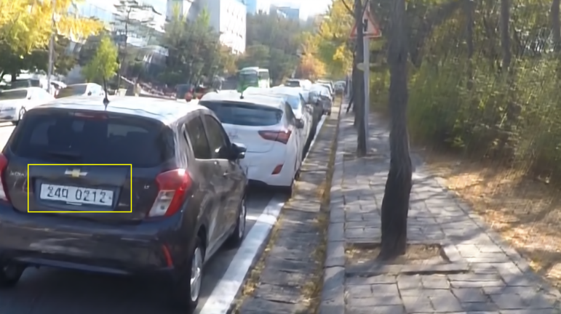



Comparison of different attention module
Introduction
Related work
Proposed method
Experiment
Training
comparison
Channel attention (25.91 / 0.8453)
Spatial attention (27.73 / 0.8865)
Conclusion
CBAM (26.70 / 0.8761)
Ground Truth

Slide 37
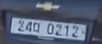
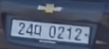
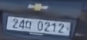
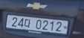
Comparison of different attention module
Introduction
Related work
Proposed method
Experiment
Channel attention (25.91 / 0.8453)
Spatial attention (27.73 / 0.8865)
Training
comparison
Conclusion
CBAM (26.70 / 0.8761)
Ground Truth

Slide 38
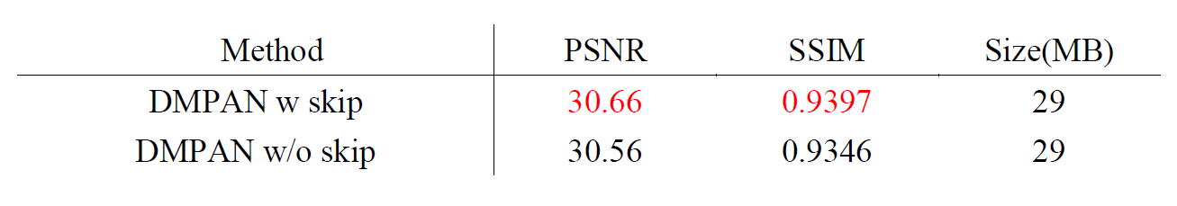
Comparison of local skip connections
Introduction
Related work
Proposed method
Experiment
Training
comparison
Conclusion

Slide 39

Comparison of local skip connections
Introduction
Related work
Proposed method
Experiment
Training
comparison
Conclusion
The training curve comparison

Slide 40

Comparison with other state-of-the-art
Introduction
Related work
CVPR 2015
Proposed method
CVPR 2017
Experiment
Training
comparison
CVPR 2018
CVPR 2019
CVPR 2019
Conclusion

Slide 41




Comparison with other state-of-the-art
Introduction
Related work
Proposed method
Experiment
SRN (30.09 / 0.9801)
DMPHN (30.43 / 0.9730)
Training
comparison
Conclusion
DMPAN (30.65 / 0.9768)
Ground Truth

Slide 42




Comparison with other state-of-the-art
Introduction
Related work
Proposed method
Experiment
SRN (30.09 / 0.9801)
DMPHN (30.43 / 0.9730)
Training
comparison
Conclusion
DMPAN (30.65 / 0.9768)
Ground Truth

Slide 43




Comparison with other state-of-the-art
Introduction
Related work
Proposed method
Experiment
Training
comparison
SRN (31.82/ 0.9580)
DMPHN (32.14 / 0.9581)
Conclusion
DMPAN (32.15 / 0.9596)
Ground Truth

Slide 44




Comparison with other state-of-the-art
Introduction
Related work
Proposed method
Experiment
SRN (31.82/ 0.9580)
DMPHN (32.14 / 0.9581)
Training
comparison
Conclusion
DMPAN (32.15 / 0.9596)
Ground Truth

Slide 45
Conclusion
Introduction
Related work
We propose a deep convolutional neural network to restore a clear high resolution image from a blurry image
We improve the network flow of multi-patch sturcture and use spatial attention mechanism to get better result
DMPAN achieves PSNR 30.66 and SSIM 0.939. The quantitative result outperform other deblurring works.
Proposed method
Experiment
Conclusion

Slide 46
reference
[1] J. Sun et al. Learning a Convolutional Neural Network for Non-uniform Motion Blur Removal CVPR 2015
[2] K. He Deep Residual Learning for Image Recognition CVPR 2015
[3] G. Huang, Z. Liu, K. Q. Weinberger, and L. Maaten. Densely connected convolutional networks. In CVPR, 2017
[4] S. Nah Deep Multi-scale Convolutional Neural Network for Dynamic Scene Deblurring In CVPR 2017
[5] X. Tao Scale-recurrent Network for Deep Image Deblurring. In CVPR 2018
[6] H. Zhang et.al. Deep Stacked Hierarchical Multi-patch Network for Image Deblurring. In CVPR 2019
[7] J. Hu, L. Shen, and G. Sun. Squeeze-and-excitation networks. arXiv preprint arXiv:1709.01507, 2017
[8] Woo, S., Park, J., Lee, J. Y., & So Kweon, I. (2018). Cbam: Convolutional block attention module. In Proceedings of the European Conference on Computer Vision (ECCV) (pp. 3-19).

Slide 47


